Slide 1
Big Mountain Resort ticket pricing
1
Problem Identification
Recommendations and Key Findings
Modeling Results and analysis
Summary and conclusion
2
3
4

Slide 2
1. Problem Identification
1
Context
4
Constraints within solution space
Big Mountain Resort’s ticket pricing policy had been charging a premium above the average price of resorts in their market segments. They have recently installed an additional chair lift, which increases their operating cost by $1,540,000. They now want to re-evaluate their pricing policy to maintain profitability.
The proposed change in the pricing must not be exceedingly high so as to not put off the customers financially.
2
Criteria for success
5
Stakeholders to provide key insight
Aligning on a detailed plan to achieve an increase in the ticket prices, in accordance with the facilities at the resort.
Jimmy Blackbun (Director of Operations), Alesha Eisen (Database Manager)
3
Scope of solution space
6
Key data sources
Most of our work will focus on finding a trend between the different facilities at the resort and the prices. If we can show that the pricing shouldn’t just depend on the average price in the market.
The CSV file provided.

Slide 3
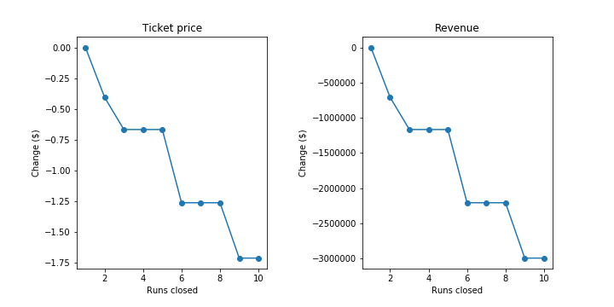
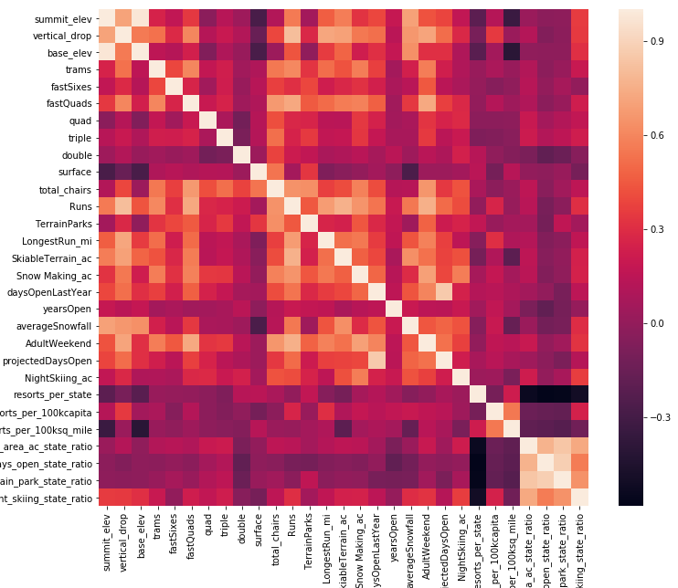
2. Recommendation and Key Findings
Recommendations:
Close down 5 runs: change in revenue will be -$1,250,000.
Increase the vertical drop by 150 ft. and install an additional chair lift: change in revenue will be +$3,500,000.
Expected increase in revenue:
+$3,500,000 - $1,250,000 = +$2,250,000
Expected change in ticket price: +$1.99

Slide 4
2. Modeling Results & Analysis
Modeling Scenario 1:
Close up to 10 of the least used runs. How would this affect the ticket price and the revenue?
Analysis:
The model suggests that closing down 1 run makes no difference to the price or the revenue generated.
Closing 2 and 3 successively reduces support for ticket price and so revenue.
If Big Mountain closes down 3 runs, it seems they may as well close down 4 or 5 as there's no further loss in ticket price.
Increasing the closures down to 6 or more leads to a large drop.
Change in the ticket price and the revenue with respect to the number of runs closed.

Slide 5
2. Modeling Results & Analysis
Modeling Scenario 2:
Add a run, increasing the vertical drop by 150 ft., and installing an additional chair lift. How would this affect the ticket price and the revenue?
Results & Analysis:
This scenario increases the support for the ticket price by $1.99. Over the entire season, this increase in ticket price could lead to a revenue increase of $3,474,638. Therefore, this is an overall profitable scenario.
Modeling Scenario 3:
Add a run, increasing the vertical drop by 150 ft., and installing an additional chair lift. In addition to this, add 2 acres of snow making. How would this affect the ticket price and the revenue?
Results & Analysis:
This scenario increases the support for the ticket price by $1.99. Over the entire season, this increase in ticket price could lead to a revenue increase of $3,474,638. Therefore, such a small increase in the snow making area makes no difference in revenue. However, this can be a contributing factor in the increase in maintenance costs. We recommend not adding the 2 acres of snow making.

Slide 6
2. Modeling Results & Analysis
Modeling Scenario 4:
Increase the longest run by 0.2 mile, guaranteeing its snow coverage by adding 4 acres of snow making capability. How would this affect the ticket price and the revenue?
Results & Analysis:
This scenario increases the support for the ticket price by $1.99. Therefore, there is no difference whatsoever in terms of increase in the ticket prices. We would recommend not pursuing this scenario, as it adds to maintenance costs, but doesn’t lead to an increase in revenue.

Slide 7
4. Summary and Conclusion
The data pertaining to resorts all across the country was cleaned, transformed and modeled to find the average price of tickets, given other features.
According to the predictions of our model, it seems that the best course of action that Big Mountain Resort can take is to close down 6 of the least used runs, install an additional chair lift and add 150 ft. of vertical drop. This will lead to a net profit of around $2,250,000.
However, to create a better model that is more accurate, we will need more data, and possibly more features like average number of visitors, average length of their stay, etc.

